Slide 1
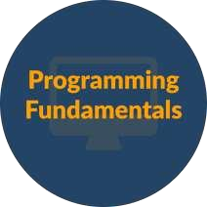

P r o g r a m m i n g F o u n d a t i o n W i t h
P s e u d o c o d e

Slide 2



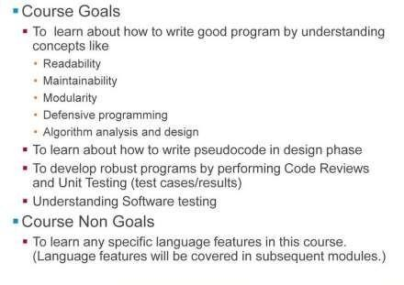
Course Goals And Non Goals
Slide 2
Course Url

Slide 3

Intended Audience
Slide 3
Course Url

Slide 4

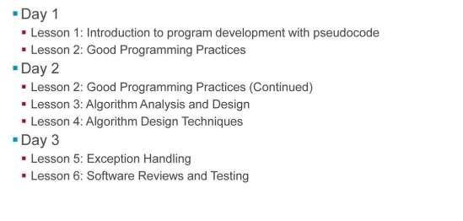
Day wise Schedule
Slide 4
Course Url

Slide 5
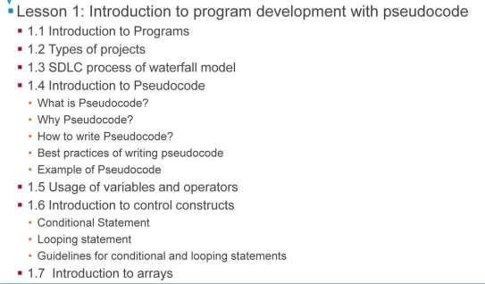

Table of Contents
Slide 5
Course Url

Slide 6

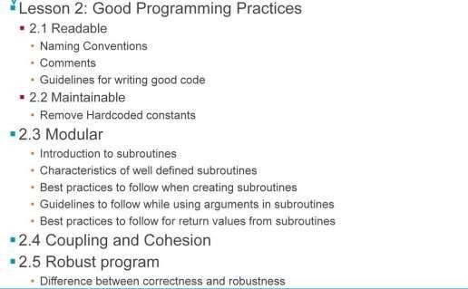
Table of Contents
Slide 6
Course Url

Slide 7
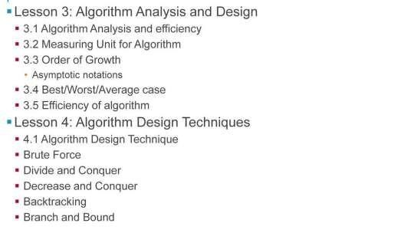

Table of Contents
Q u est io n s
Slide 7
Course Url

Slide 8
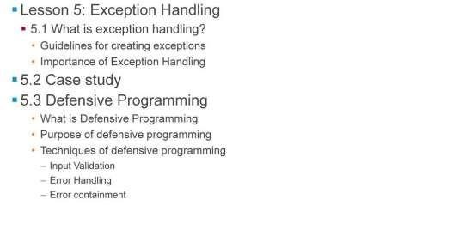
Table of Contents
Q u est io n s
Slide 8
Course Url

Slide 9
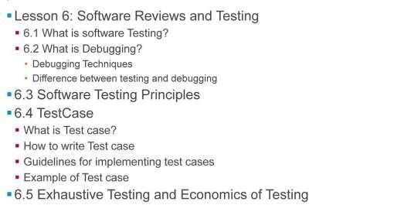
Table of Contents
Q u est io n s
Slide 9
Course Url

Slide 10
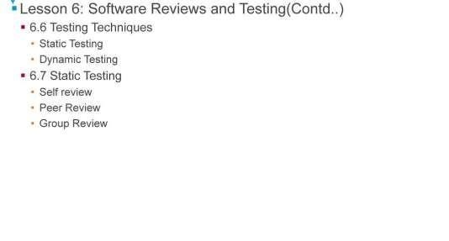
Table of Contents
Q u est io n s
Slide 10
Course Url

Slide 11
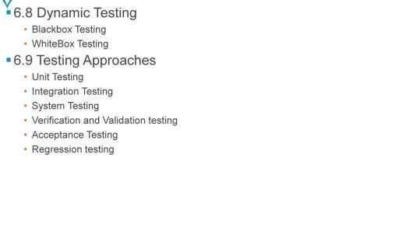
Table of Contents
Q u est io n s
Slide 11
Course Url

Slide 12
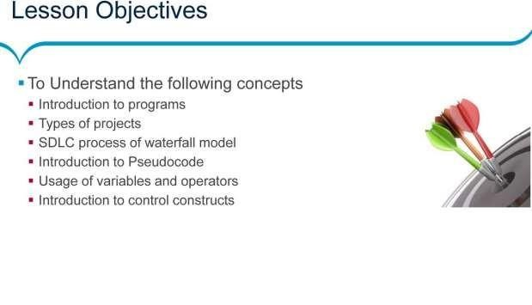
Lesson-1::Introduction to program development with pseudocode
Q u est io n s
Slide 12
Course Url

Slide 13
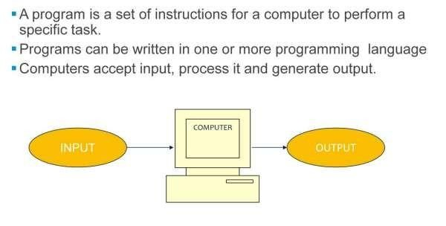
What is a Program?
Q u est io n s
Slide 13
Course Url

Slide 14
What is a Program?
→Program is Set of instructions for a computer to perform a specific task. Programs can be written in one or more programming language.
→Example: Program to receive employee details as an input, then calculate and display the gross and net salary of an employee.
→What is Programming Language?
→• Used to feed instructions to the computer
→• Can be categorized as Machine language, Assembly language, Compiled Languages, Interpreted Languages, Object Oriented Languages … etc
→• Languages which are more simpler, easier are referred as High-Level Languages
→• Low level languages provides little or no abstraction to the internal working of microprocessor.
Slide 14
Course Url

Slide 15
Application, Program And Software
→Program: Set of ordered instructions that enable a computer to carry out a specific task. A collection of instructions that tell the computer what to do.
→Ex: Program to find a prime number, Program to print employee pay slip etc..
→Application : Any program designed to perform a specific function.
→Ex : Notepad, M S Paint etc..
→Software: A set of programs and associated documentation concerned with a specific operation stored electronically.
→Ex : Microsoft Office, Oracle etc..
Slide 15
Course Url

Slide 16
Industry LevelProjects
Consider the scenario of a College:
Throw away programs
These programs are not used by any one later
Same Users / Developers
Small assignments: 1-2 person teams
No commercial angle
Familiar application domain
Low criticality
Traditional single-machine architecture
Slide 16
Course Url

Slide 17
Industry LevelProjects
Industry level programs should be
Readable : Easy to read and understand the code at any time since lifetime of projects will be longer in terms of years.
Maintainable : If the program is easy to understand and If it is easy to modify then the program is called as maintainable
Modular : A small unit of code for a single purpose
Reliable : Reliability describes about the ability of a system will work perfectly as stated without failure or error
Robust : The ability of a system to continue operating despite abnormalities in input, calculations, etc.
Efficient : A task which gets done in the specified time with desired quality
Easy to use: Program which is easy to use by the end users
Flexible
Extendable : If the additional features of a program is possible to be included without any side effects, then the program is called as extendable.
Reusable : If the task written in program is called multiple times, then the program is reusable.
Slide 17
Course Url

Slide 18

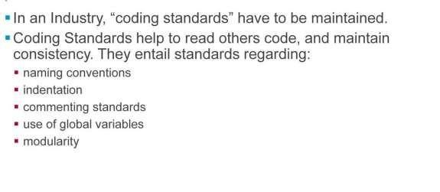






Industry Level projects
LIVEOnlineClass
Class Recording in LMS 24/7 Post ClassSupport Module Wise Quiz Project Work
Verifiable Certificate
Slide 18
Course Url

Slide 19
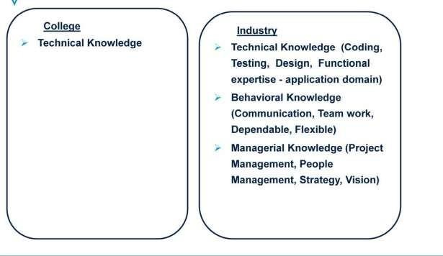
Skil s Required
LIVEOnlineClass
Class Recording in LMS 24/7 Post ClassSupport Module Wise Quiz Project Work
Verifiable Certificate
Slide 19
Course Url

Slide 20
Skil s Required
→A person require much more technical knowledge for writing industry level applications as compared to writing programs in the college. In college having good technical knowledge for a particular technology is enough to write program but in industry along with technical knowledge you require some other knowledge like
» • What are good programming practices?
» • How to write test cases?
» • You also should have domain knowledge.
» • As we need to work in a team in industry, you also need to improve your communication knowledge.
You should be dependable and flexible.
» • To reach at managerial level, you need to acquire people management skill, Project management skill
over a period of time along with the technical skills.
Slide 20
Course Url

Slide 21
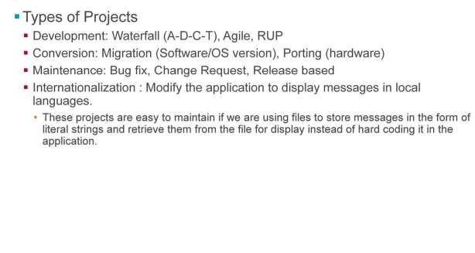
Types of Projects in Industry
LIVEOnlineClass
Class Recording in LMS 24/7 Post ClassSupport Module Wise Quiz Project Work
Verifiable Certificate
Slide 21
Course Url

Slide 22
Types of Projects in Industry
In an industry there are various types of projects like
Development Projects: In these projects we may use different types of life cycles like Waterfall model, Agile, RUP (Rational Unified Process) you need to be familiar with these terms
Conversion Projects
Migration - It refers to projects like upgrading a software to different version of the OS or DBMS systems
Porting – If there is major change in the system like, Hardware Platform has changed.
Maintenance projects
Bug fix – If there is an unwanted behavior exists in an existing system due to bug(Problem), then fix the bug by doing changes.
Change request – If there are any changes in the functionality are requested from customer such projects are called as
changed request type of project.
Release base – Products for which periodically the new release of the product is made
Internationalization : Normally most of the applications display messages to user in English but in some cases we may need to change the application to display messages in local language based on the location where we are using it. In such type of projects we need to change the code accordingly. If we have hard coded the messages in the applications then maintenance will be the tedious activity. Hence the good solution for it is store the messages in a file in the form of literal strings and use these files for displaying messages.
Slide 22
Course Url

Slide 23
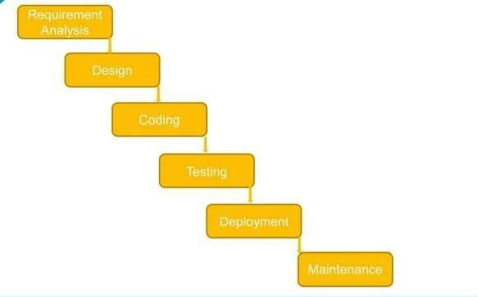
SDLCprocess of Waterfall Model
LIVEOnlineClass
Class Recording in LMS 24/7 Post ClassSupport Module Wise Quiz Project Work
Verifiable Certificate
Slide 23
Course Url

Slide 24
SDLCprocess of Waterfall Model
Waterfall Model: The waterfall model is a sequential software development model in which development is seen as flowing steadily downwards (like a waterfall) through the phases of requirements analysis, design, coding, testing (validation), deployment, and maintenance.
SDLC process of Waterfall Model:
Requirement Analysis : Identify all the requirements. After requirement gathering, analyze the requirements for
identifying their validity and the possibility of incorporating the requirements in the system to be developed.
Design: It is a process of creating a detailed specification for a software module . It involves algorithmic design and other implementation specific approaches for a s/w component such as modularity , control hierarchy,, data structures etc. Designers/Technical leads ,senior developers , architects are involved in this phase
Coding : Main objective of this phase is to translate the software design into code , each component identified in design is implemented as a program module following coding guidelines
Testing : Process of checking what’s been developed against the requirement.
Deployment : Process of bringing the system into production environment
Maintenance : The maintenance phase involves making changes to hardware, software, and documentation to support its operational effectiveness.
Slide 24
Course Url

Slide 25
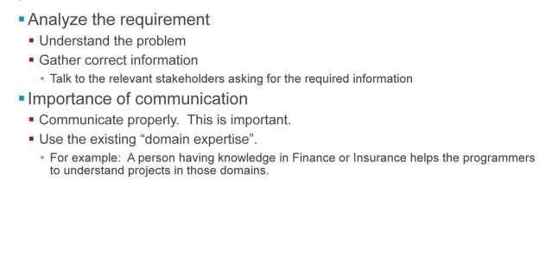
Requirement Analysis Phase
LIVEOnlineClass
Class Recording in LMS 24/7 Post ClassSupport Module Wise Quiz Project Work
Verifiable Certificate
Slide 25
Course Url

Slide 26
Requirement Analysis Phase
Analyze the requirement:
Understand the Problem:
Interpret the problem in your own words
Determine the outputs required
Identify the inputs required to obtain the desired output
List out the clarifications required
List the assumptions made
List the constraints / limitations
Gather Correct Information: Gather the required information from the concern stakeholders by communicating with them.
Importance of proper communication: User talks in language of business, and Programmer talks in the language of technology. Since there is a big gap between these languages, understanding the requirements properly is very important. This is possible through proper communication. The communication exercise is as follows:
Consider income tax calculation logic is written by you. If you want to check whether the Income Tax calculation written in the program, is correct as per the current Tax laws? Where can you get this information?
Draft an email to the relevant stakeholders, requesting for the required information.
Slide 26
Course Url

Slide 27
LAB-CaseStudy-ATM
The ATM application aims at performing ATM transactions and balance enquiry of an existing account holder in a user friendly way Following is a list of functionalities of the system. Wherever, the description of functionality is not adequate; you can make appropriate assumptions and proceed.
The user is requested for the card number and his personal pin number for authentication purpose.
After authenticating the user, the application requests the user to choose any one of the following options:
BALANCE ENQUIRY
CASH WITHDRAWL
MINI STATEMENT
QUIT.
When the user chooses one of the above options, say ‘1’, the balance of the user is retrieved and displayed. The application further requests the user whether he/she wants the report to be generated and responds accordingly.
When the user chooses ‘2’, transaction is performed based on the request of the user with the help of the transaction file. Thus after the transaction is complete the user’s account is updated.
Slide 27
Course Url

Slide 28
LAB-CaseStudy-ATM(Cont..)
When user wants to generate a record for his/her last 5 DAYS transaction, mini statement is opted where details retrieved from Transaction History File. Updating balance is done when recharge is successful in Master and Transaction File. Thus, the application requests the user for further processing and responds based on the input from the user.
Case Study 1: In a firm there are 10 salespeople and incentive is paid on the portion of sales that exceeds two thirds of the average sales of the group. List the salesperson receiving incentives along with their incentive amount. Incentive amount is 20% the amount of sales that exceeds the two thirds of the average.
Case Study 2: All candidates have to take three tests. Selection for the interview round is done based on the scores of all the three tests. The individual score in each test has to be greater that 75 and the average score across the three tests should be a minimum of 80. An interview call letter is to be sent to candidates who have been selected and a reject letter is to be sent to the others. The interview stage involves two rounds:
Round 1: qualifying criterion: rating of greater than five on a scale of 1 to 10
Round 2: qualifying criterion: rating of greater than seven on a scale of 1 to 10Candidates go through both rounds of interview.
Selected candidates are sent offer letters and the rest are sent reject letters.
Represent the logic for finding the number of candidates who have been sent interview call letters, who have been sent
reject letters and who have been sent offer letters.
Slide 28
Course Url

Slide 29
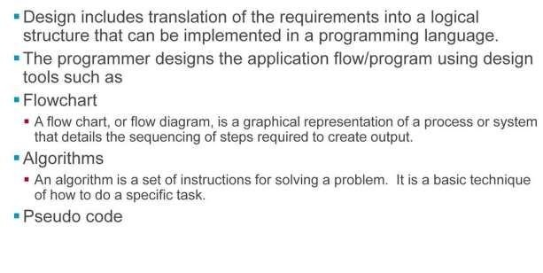
Design Phase
LIVEOnlineClass
Class Recording in LMS 24/7 Post ClassSupport Module Wise Quiz Project Work
Verifiable Certificate
Slide 29
Course Url

Slide 30
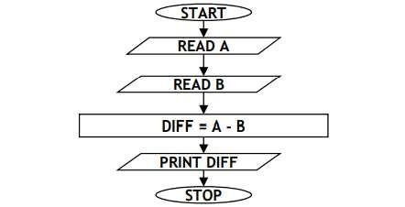
Design Phase
Flowchart: A flow chart, or flow diagram, is a graphical representation of a process or system that details the sequencing of steps required to create output. A typical flow chart uses a set of basic symbols to represent various functions, and shows the sequence and interconnections of functions with lines and arrows. Ex: Flow chart to calculate difference b/w two numbers:
Slide 30
Course Url

Slide 31
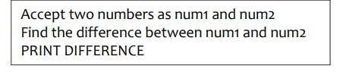
Design Phase
Algorithm: An algorithm is a set of instructions for solving a problem. It is a basic technique of how to do a specific task. It takes input, processes it according to a set of instructions, and generates output. An algorithm must provide correct output for every possible input condition. An algorithm must have a definite end point so that when the input has been processed and the desired output achieved, the process stops. Example: Algorithm to calculate the difference between two numbers.
Slide 31
Course Url

Slide 32
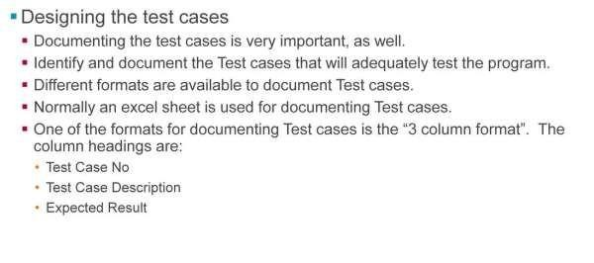
Design Phase
Slide 32
Course Url

Slide 33
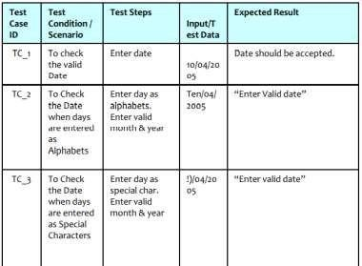
Design Phase
Test case “A set of test inputs, execution conditions, and expected results developed for a particular objective, such as to exercise a particular program path or to verify compliance with a specific requirement.” See the sample test cases given below for checking valid date.
Slide 33
Course Url

Slide 34
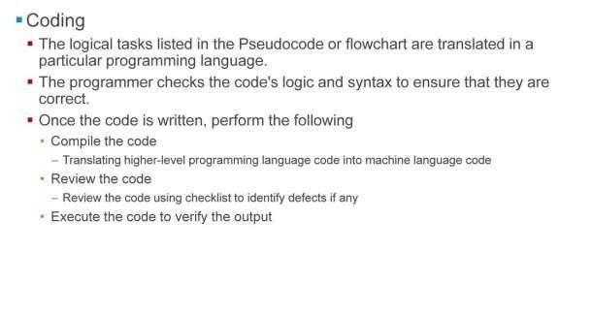
Coding
Slide 34
Course Url

Slide 35
Coding
Compiling the code:
Computers can execute machine language code only.
The process of translating higher-level programming language code into machine language code is called compiling the program. Special programs, called compilers and interpreters, perform this task.
Code that has errors in it cannot be compiled. The compiler will flag the error, and the programmer must fix the error before trying to compile the code again
Execute the program and verify the output:
Once a program is compiled, it can be executed.
The programmer checks the program's output to ensure that it is correct
Logic of the program can be checked by using sample inputs and comparing the output obtained with the expected output identified during creation of test cases
Slide 35
Course Url

Slide 36
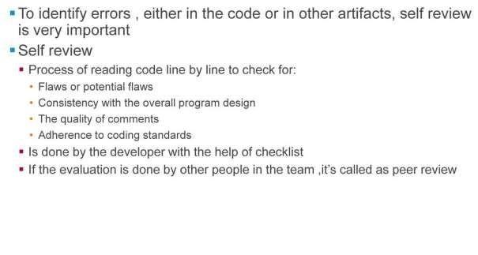
Review
-> Self review is a process done by the author himself with the aid of tools like checklist, review guidelines, etc.. Checklist is a tool with which review can be performed. Checklist is available as an excel document used to verify that all the requirements mentioned in requirement specification is covered and best practices, coding standards are followed.
Slide 36
Course Url

Slide 37
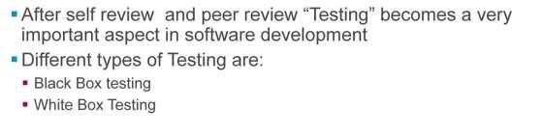
Testing
Different types of testing:
Black Box testing is a software testing method focused on testing whether the input is properly accepted, and output is correctly produced in an application. For an Example, if you want to validate the given input, then use black box testing.
White Box testing is also a software testing method focused on testing the internal structure of the code. For an example, any unreachable path is identifiable using white box testing.
Slide 37
Course Url

Slide 38
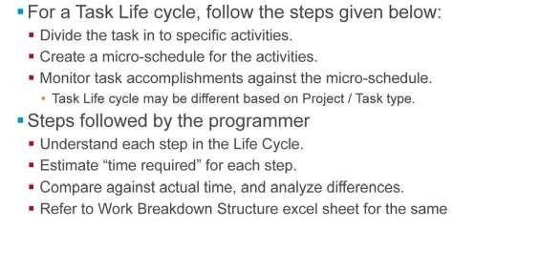
Micro-Level Plan
Slide 38
Course Url

Slide 39
Micro-Level Plan
If any of the task is assigned to a programmer then to complete it in time follow the task life cycle.
The task life cycle means, divide the task in to smaller activities which should be performed in the sequence to
complete the task.
Decide the time lines for every activity and prepare a micro schedule for the activity
Monitor the accomplishment for every activity against the schedule prepared in the previous step. So that we
can take care of timely completion of the task. It will also help to improve our ability to estimate the timelines to complete the task.
Task life cycle will be different for different project or different task type And hence programmer should first understand each step in the life cycle. Estimate the time required for each step and monitor the task completion against the plan
Slide 39
Course Url

Slide 40
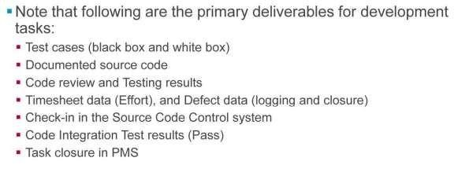
Deliverables
We need to submit above mentioned deliverables. In defect data we need to log the defect and also mention the closure of it. Submit the code to configuration management (Check-in in the Source Code Control system). Once the integration test is pass then close the task in PMS (Project Management system). i.e we are ready to work on another task.
Slide 40
Course Url

Slide 41
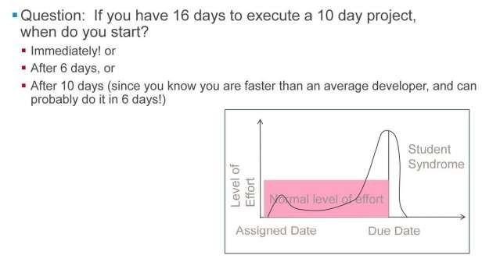
Student Syndrome
Slide 41
Course Url

Slide 42
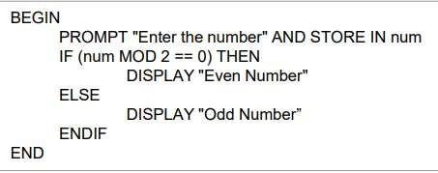
What is Pseudocode?
What is Pseudocode?
Pseudocode is a natural language description of what a computer program must do rather than in a programming language.
It allows the developer to focus on the logic of the code without being distracted by details of programming language syntax.
At the same time, the pseudocode needs to be complete. It describe the entire logic of the task so that implementation becomes easier for translating the task line by line into source code.
The pseudocode describes the logic of the program and acts as a blueprint for the source code to be written by the programmer. PseudoCode for Finding Whether a number is odd or even:
PROMPT is a Pseudocode keyword used to take inputs from the keyboard and store in a variable.
Slide 42
Course Url

Slide 43
Why Pseudocode ?
Why Pseudocode ?
Easy and Efficient Coding – Easy to solve the task by focusing only on logic of the code with pseudo code rather
than any other programming language.
Increase the Quality of program – Easy way for Analyst to ensure the code matches with design specifications. Once it is matched, then they can easily convert the pseudocode into project specific Language. Thus it helps to ensure requirements are met and that program code meets good software development practice.
Less Cost activity. Since Catching Logical errors is less tedious than catching them in development process.
Slide 43
Course Url

Slide 44
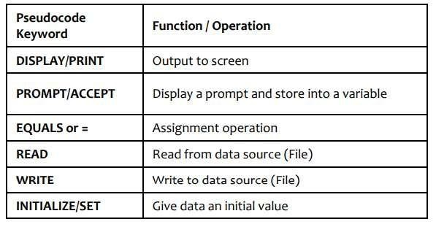
How to Write Pseudocode
Rules to be followed While writing pseudo Code:
All statements are written as sentence. Use Words and Phrases which are in line with basic computer operations.
No variable declarations. Use unique variable names but there is no need to declare them before they are used. • There is no universal "standard" Code for writing Pseudo Code. But for understandable by others in the project follow the common coding
standards specific to the project.
Some of the Common Coding Notations are:
Slide 44
Course Url

Slide 45
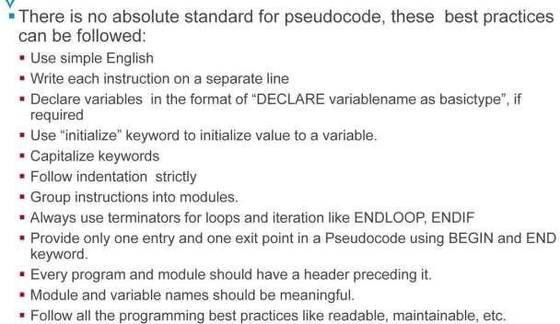
Best Practices of Writing Pseudocode
Slide 45
Course Url

Slide 46
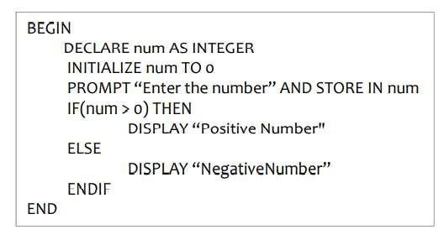
Best Practices of Writing Pseudocode
Pseudocode Example with best practices:
Slide 46
Course Url

Slide 47
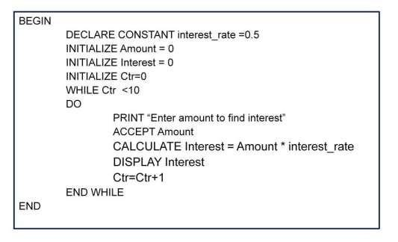
Example of Pseudocode
The above pseudocode is used to calculate interest for a given amount based on fixed interest rate. This process will be repeatedly executed for 10 times. Fixed Interest Rate is 0.5. Formulae used to calculate interest is
Amount * Fixed Interest Rate
Slide 47
Course Url

Slide 48
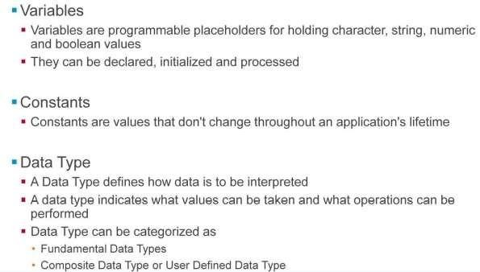
What are Variables,Constants And Datatypes?
Slide 48
Course Url

Slide 49
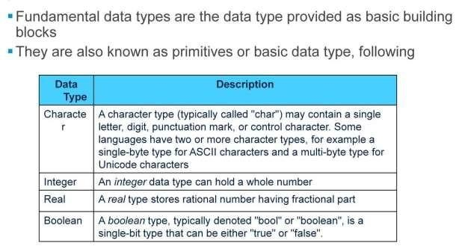
Fundamental Datatypes
Slide 49
Course Url

Slide 50
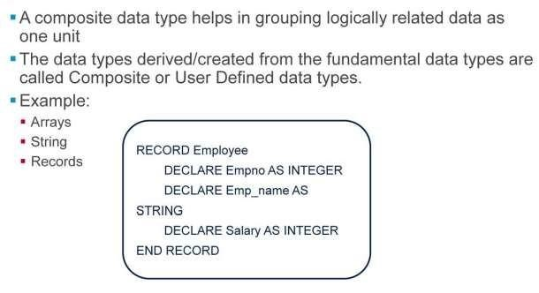
Composite Datatypes
Slide 50
Course Url

Slide 51
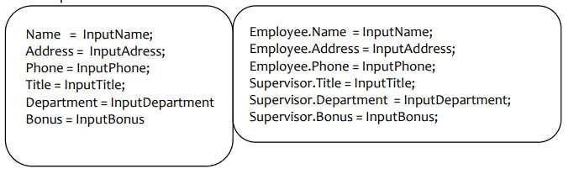
Composite Datatypes
“Structured data” refers to data that’s built up from other types. Use them to clarify relationships between related items
Example :
Why to create user defined datatypes?
->To increase reliability One could specify the range of values that a variable of a User Defined data type can take.
->To make up for language weakness If a language does not support a type the user wants, it is possible to create it yourself. Example, a student in ‘C
Slide 51
Course Url

Slide 52
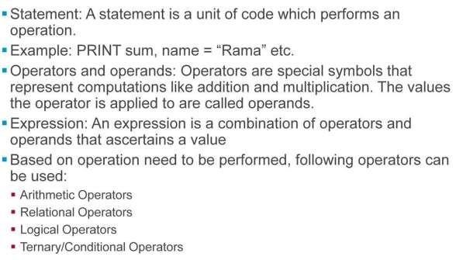
Statement, Operators And Expressions
Slide 52
Course Url

Slide 53
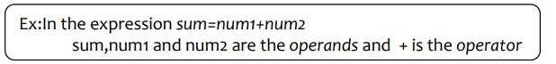
Statement, Operators And Expressions
Operators and operands, Expression An operator is a symbol that represents a specific action that must be performed on data.
Operators have rules of precedence and associativity that are used to determine how expressions are evaluated. Expressions: An Expression is a combination of constants and variables together with the operators. Constants and variables by themselves are also considered as expressions. An expression that involves only constants is called a Constant Expression. Note: Balanced parentheses can be used in combining constants and variables. Operators have been classified into categories based on the operation that they perform. Refer the slide for the different categories.
Slide 53
Course Url

Slide 54
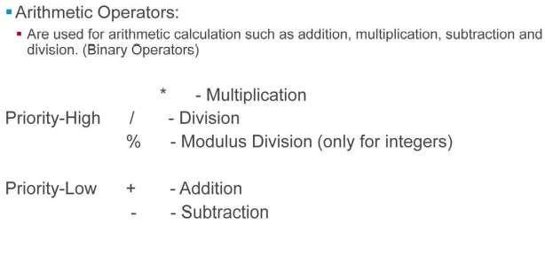
Arithmetic Operators
Types of Operators:
Arithmetic Operators: There are five types of arithmetic operators that are used for arithmetic calculations such as, addition, subtraction, multiplication and division. These five operators are binary operators that is, they require two operands. Each of these operators work with values of type integers, Real and character.
Slide 54
Course Url

Slide 55
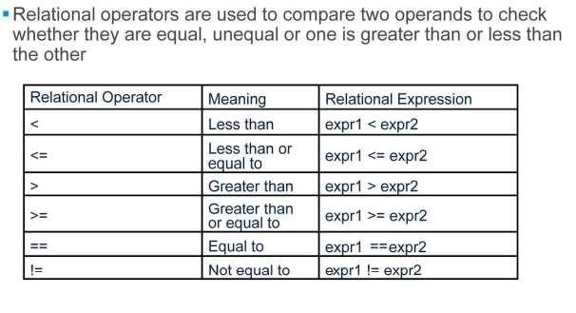
Types of Operators:
Relational Operators: Relational Operators are used to compare two operands to check whether they are equal, unequal or one is less than or greater than the other. There are six relational operators for comparing the values of two expressions and the expression so formed is called a Relational Expression. Table provided in the slide shows relational operators and how they can be used to compare expressions expr1 and expr2.
Slide 55
Course Url

Slide 56
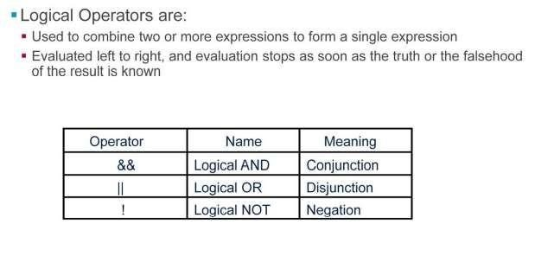
Logical Operators
Slide 56
Course Url

Slide 57
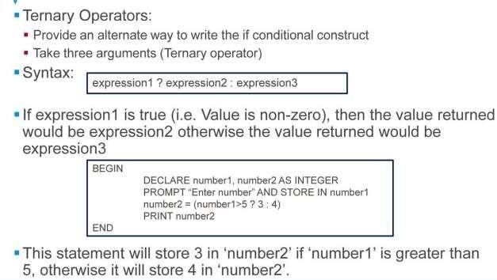
Ternary/Conditional Operator
Slide 57
Course Url

Slide 58
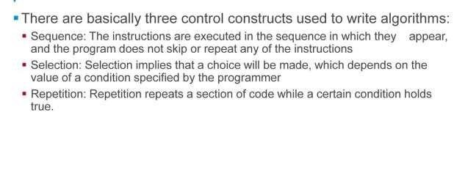
Introduction to Controlconstructs
Slide 58
Course Url

Slide 59
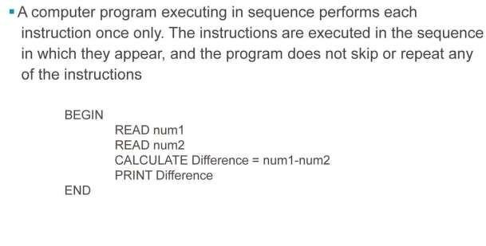
Control Constructs - Sequence
Slide 59
Course Url

Slide 60
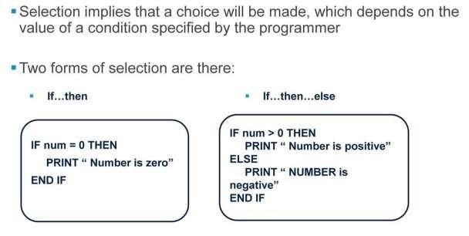
Control Constructs - Selection
Slide 60
Course Url

Slide 61
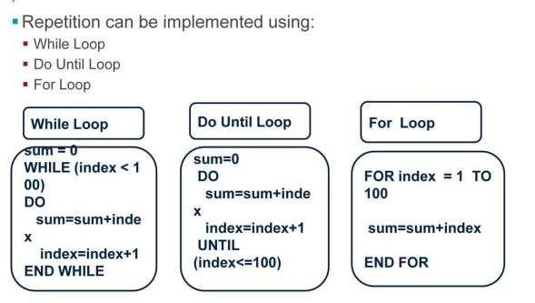
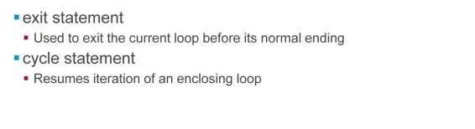
Control Constructs – looping Statements
Slide 61
Course Url

Slide 62
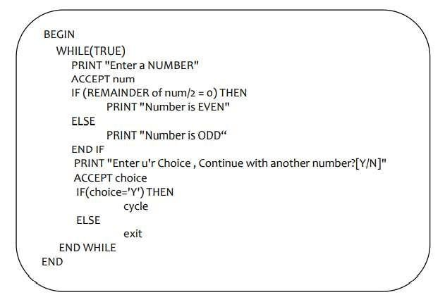
Control Constructs – Looping Statements (contd..)
Slide 62
Course Url

Slide 63
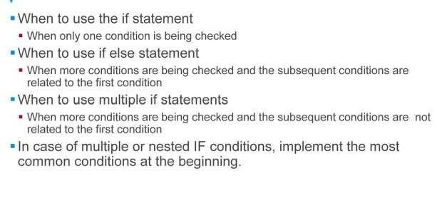
Guidelines for conditional Statements
Slide 63
Course Url

Slide 64

Guidelines for LoopingStatements
Slide 64
Course Url

Slide 65

Demo: Variables, Operators And Control Constructs
Slide 65
Course Url

Slide 66

Introduction to Arrays
Slide 66
Course Url

Slide 67

Example of Array
Slide 67
Course Url

Slide 68

Write pseudocode for all the assignments mentioned in Lab 1 for practicing on the usage of variables, operators, control constructs and arrays
Lab
Slide 68
Course Url

Slide 69

Summary
Slide 69
Course Url

Slide 70

Review Questions
Slide 70
Course Url

Slide 71

Review Questions
Slide 71
Course Url

Slide 72

Review Questions
Slide 72
Course Url

Slide 73

Review Questions
Slide 73
Course Url

Slide 74

Review Questions
Slide 74
Course Url

Slide 75

Lesson-2:: Good Programming Practices
Course Url

Slide 76

Characteristics of a good program
Course Url

Slide 77

Characteristics of a good program
Course Url

Slide 78

Naming Conventions
Course Url

Slide 79

Naming Conventions
Course Url

Slide 80

Naming Conventions
Course Url

Slide 81

Naming Conventions
Course Url

Slide 82

Naming Conventions
Course Url

Slide 83

Optimum NameLength
Course Url

Slide 84

Optimum NameLength
Course Url

Slide 85

Layout Techniques
Course Url

Slide 86

Layout Techniques
Course Url

Slide 87

Layout
Course Url

Slide 88

Layout
Course Url

Slide 89
Layout
Course Url

Slide 90

Layout
Course Url

Slide 91

Layout Techniques:
Course Url

Slide 92

Self-Documenting Code:
Course Url

Slide 93

Self-Documenting Code:
Course Url

Slide 94

Kinds of comments
Course Url

Slide 95

Kinds of comments
Course Url

Slide 96

Commenting Techniques
Course Url

Slide 97

Commenting Techniques
Course Url

Slide 98

Maintainable
Course Url

Slide 99

Maintainable
Course Url

Slide 100

Maintainable-Example
Course Url

Slide 101

Maintainable-Example
Course Url

Slide 102

Program for printing pay-slip(Example-2)
Course Url

Slide 103

Program for printing pay-slip(Example-2)
Course Url

Slide 104

Program for printing pay-slip-isseus
Course Url

Slide 105

Program for printing pay-slip-isseus
Course Url

Slide 106

Program for printing pay-slip-solution
Course Url

Slide 107

Program for printing pay-slip-solution
Course Url

Slide 108

Program for printing pay-slip-solution
Course Url

Slide 109

Program for printing pay-slip-solution
Course Url

Slide 110

Program for printing pay-slip-solution
Course Url

Slide 111

Program for printing pay-slip-solution
Course Url

Slide 112

Program for printing pay-slip-Example
Course Url

Slide 113

Program for printing pay-slip-Example
Course Url

Slide 114

Modular
Course Url

Slide 115

Modular
Course Url

Slide 116

Reasons for creating a module
Course Url

Slide 117

Reasons for creating a module
Course Url

Slide 118

Advantages of Modularity
Course Url

Slide 119

Advantages of Modularity
Course Url

Slide 120

Characteristics of well defined Modules
Course Url

Slide 121

Characteristics of well defined Modules
Course Url

Slide 122

Best practices to follow when creating modules
Course Url

Slide 123

Best practices to follow when creating modules
Course Url

Slide 124

Example-1
Course Url

Slide 125

Solution-1
The above pseudocode for calculating bill amount is not modularized
Course Url

Slide 126

Solution-2
The above pseudocode for calculating bill amount is modularized
Course Url

Slide 127

Code Considerations During Modularization
Course Url

Slide 128

Code Considerations
Course Url

Slide 129

Guidelines to follow while usingarguments
Course Url

Slide 130

Guidelines to follow while usingarguments
Course Url

Slide 131

Best Practices to follow for return values
Course Url

Slide 132

Best Practices to follow for return values
Course Url

Slide 133

Guidelines to follow while writing acode
Course Url

Slide 134

Guidelines to follow while writing acode
Course Url

Slide 135

Coupling
Course Url

Slide 136

Coupling
Course Url

Slide 137

Coupling
Course Url

Slide 138

Coupling
Course Url

Slide 139

Cohesion
Course Url

Slide 140

Cohesion
Course Url

Slide 141

Example
Course Url

Slide 142

Example
Course Url

Slide 143

Change request example
Course Url

Slide 144

Change request example
Course Url

Slide 145

Drawbacks in a givencode
Course Url

Slide 146

Drawbacks in a givencode
Course Url

Slide 147

How can we avoid this?
Course Url

Slide 148

How can we avoid this?
Course Url

Slide 149


Revised code
The calls to fread / fwrite / fopen / fclose are encapsulated or wrapped in the modules ReadCust / WriteCust / OpenCust / CloseCust respectively.
Course Url

Slide 150

Revised code
Used STATIC variable(cust-file-already-open) to represent the STATE of the file as OPEN or not
Course Url

Slide 151

Coupling and cohesionAdvantages
Course Url

Slide 152

What is robust program?
Course Url

Slide 153

What is robust program?
Course Url

Slide 154

Example
Course Url

Slide 155

Example
Course Url

Slide 156

Defects introduced in the program
For resolving all the defects mentioned in the slide, rework on the code.
Course Url

Slide 157

Example of robust program
Course Url

Slide 158

Example of robust program
Course Url

Slide 159

Make a program robust
Course Url

Slide 160

Make a program robust
Course Url

Slide 161

Differences between correctness and robustness
Course Url

Slide 162

Differences between correctness and robustness
Course Url

Slide 163

Definition of refoctoring
Course Url

Slide 164

Definition of refactoring
Course Url

Slide 165

Benefits of refactoring
Course Url

Slide 166

Benefits of refactoring
Course Url

Slide 167

Refactoring task to the code issue it addresses
Each refactoring task is addressed to the code issue it addresses.
Course Url

Slide 168

Refactoring example
Course Url

Slide 169

Refactoring example
Course Url

Slide 170

Refactoring example
Course Url

Slide 171

Refactoring example
Course Url

Slide 172

Lab
Write pseudocode for all assignments in lab 2 to apply the characteristics of good programming practices like modularity approach.
Course Url

Slide 173

Summary
Course Url

Slide 174

Review Question
Course Url

Slide 175

Review Question
Course Url

Slide 176

Review Question
Course Url

Slide 177

Lesson 3::Algorithm Analysis and Design
Course Url

Slide 178

Algorithm Analysis and efficiency
Course Url

Slide 179

Algorithm Analysis and efficiency
Course Url

Slide 180

Measuring Unit for Algorithm
Course Url

Slide 181

Measuring Unit for Algorithm
Course Url

Slide 182

Measuring Unit for Algorithm
Course Url

Slide 183

Measuring Unit for Algorithm
Course Url

Slide 184

Measuring Unit for Algorithm
Course Url

Slide 185

Measuring Unit for Algorithm
Course Url

Slide 186

Order of Growth
Course Url

Slide 187

Order of Growth
Course Url

Slide 188

Examples-order of growth
Write an algorithm for the above examples before findingits efficiency.
Course Url

Slide 189

Basic efficiency classes
Course Url

Slide 190

Basic efficiency classes
Course Url

Slide 191

Best/Worst/Average cases
Course Url

Slide 192

Best/Worst/Average cases
Course Url

Slide 193

Searching Techniques
Course Url

Slide 194

Sequential Search
Course Url

Slide 195

Sequential Search
Course Url

Slide 196

Sequential Search-Example
Course Url

Slide 197

Sequential Search-Example
Course Url

Slide 198

Sequential Search-Example
Course Url

Slide 199

Binary Search-Features
Course Url

Slide 200

Binary Search-Features
Course Url

Slide 201

Binary Search-Example
Course Url

Slide 202

Comparison Example
Course Url

Slide 203

Comparison Example
Course Url

Slide 204

Comparison Example
Course Url

Slide 205

Discussion
Course Url

Slide 206

Discussion
Course Url

Slide 207

Example-MaxElement
Course Url

Slide 208

Example-MaxElement
Course Url

Slide 209

Example-MaxElement
Course Url

Slide 210

Example-MaxElement
Course Url

Slide 211

Lab
Course Url

Slide 212

Summary
Course Url

Slide 213

Review Question
Course Url

Slide 214

Lesson4::Algorithm Design Techniques
Lesson Objectives:
Slide 1

Slide 215



Algorithm Design Techniques
Algorithm Design Techniques provides various different approaches to solve a given problem. Various design techniques are available as listed in the above slide.
Brute Force: This is “Just do it” type. Easiest solution is found for a problem without any concern of the efficiency parameter.
Divide and Conquer: Here the task is divided, solution is found for the smallest unit and the solutions are conquered to derive the final
result.
Decrease and conquer: It is based on exploiting the relationship between a solution to a given instance of a problem and a solution to a smaller instance of the same problem.
Backtracking: Backtracking is a technique used to solve problems with a large search space, by systematically trying and eliminating possibilities.
Slide 2

Slide 216

Brute force – Bubble Sort
Brute force is a straightforward approach to solving a problem, usually directly based on the problem statement and definitions of the concepts involved. “Just do it!” would be another way to describe the prescription of the brute-force approach. Brute Force solutions will not have concerns for the efficiency parameters. Example for Bubble sort is explained in detail in the above slides.
Slide 3

Slide 217


Bubble Sort Algorithm
Slide 4

Slide 218

Divide and Conquer
The divide-and-conquer technique involves solving a particular computational problem by dividing it into one or more subproblems of smaller size, recursively solving each subproblem, and then “merging” or “marrying” the solutions to the subproblem(s) to produce a solution to the original problem. Quite a few very efficient algorithms are specific implementations of this general strategy. Divide and conquer technique work according to the following steps,
→A problem is divided into several subproblems of the same type, ideally of about equal size.
→The subproblems are solved.
→If necessary, the solutions to the subproblems are combined to get a solution to the original problem. Note: Not every divide-and- conquer algorithm is necessarily more efficient than even a brute-force solution.
Slide 5

Slide 219

Divide and Conquer – Merge Sort
Consider above given input, 5,1,4,2,10,3,9,15. First the task is divided in smallest unit as shown below.
Slide 6

Slide 220

ADT - Divide and Conquer
Efficiency of Merge Sort
CBest(n)=O(nlogn) CWorst(n)=O(nlogn) CAvg(n)=O(logn)
Efficiency of Quick Sort
CBest(n)=O(nlogn)
CWorst(n)=O(n2) [Depends on the pivot element chosen] Avg(n)=O(1.38nlogn)
Slide 7

Slide 221

Decrease and Conquer – Insertion sort
Decrease and Conquer: It is based on exploiting the relationship between a solution to a given instance of a problem and a solution to a
smaller instance of the same problem.
There are three major variations of decrease-and-conquer: - decrease by a constant : In the decrease-by-a-constant variation, the size of an instance is reduced by the same constant on each iteration of the algorithm. Typically, this constant is equal to one - decrease by a constant factor: The decrease-by-a-constant-factor technique suggests reducing a problem instance by the same constant factor on each iteration of the algorithm. - variable size decrease: The size-reduction pattern varies from one iteration of an algorithm to another.
Slide 8

Slide 222
Insertion Sort - Example
Example: Consider the following array
a. 5 7 0 3 4 2 6 1.
On the left side the sorted part of the sequence is shown as underline. For each iteration, the number of positions the inserted element has moved is shown in brackets.
5 7 0 3 4 2 6 1.(0) – Initially only a[0] element is sorted
Consider element at a[1] 7 > 5 , So no change will be there and sorted part will increase from a[0] to a[1] 5 7 0 3 4 2 6 1 (0)
Consider element at a[2] we will copy it in index variable and check 7 >0, 5>0 hence 5 and 7 will get shifted to one location on right and put 0 at a[0] location Now the size of sorted part is 3 0 5 7 3 4 2 6 1 (2)
Similarly we will place element 3 from a[3] to a [1] position and array will be as follows 0 3 5 7 4 2 6 1 (2)
In further iterations array will get sorted as follows 0 3 4 5 7 2 6 1 (2) - 4 will be inserted at a[2] position 0 2 3 4
7 6 1 (4) - 2 will be inserted at a[2] position 0 2 3 4 5 6 7 1 (1) - 6 will get inserted at a[4] position 0 1 2 3 4 5
7 (5) - 1 will be inserted at a[1] position
Slide 9

Slide 223

Insertion Sort - Features
Efficiency of insertion sort is O(n2).
More efficient sorting algorithms are merge sort, heap sort and quick sort. Their efficiency falls under nlogn class but they are restricted with their own conditions. Hence it depends on the input type to decide which algorithm must be used for a given application.
Slide 10

Slide 224

Backtracking – N Queens Problem
Both backtracking and branch-and-bound are based on the construction of a state-space tree whose nodes reflect specific choices made for a solution’s components. Both techniques terminate a node as soon as it can be guaranteed that no solution to the problem can be obtained by considering choices that correspond to the node’s descendants. Difference is that Branch and Bound is only applied to the optimization problems where as Backtracking does not have any such constraints. The other difference is that the order in which nodes of the state-space tree are generated. Backtracking uses DFS and Branch and bound uses various rules, one of them is best-first rule.
Slide 11

Slide 225

Backtracking – N Queens Problem
Slide 12

Slide 226

Backtracking – N Queens Problem
Slide 13

Slide 227

Backtracking – N Queens Problem
Lets place queen 1 in the first possible position of its row, which is in column 1 of row 1. Then we place queen 2, after trying unsuccessfully columns 1 and 2, in the first acceptable position for it, which is square (2, 3), the square in row 2 and column 3. This proves to be a dead end because there is no acceptable position for queen 3. So, the algorithm backtracks and puts queen 2 in the next possible position at (2, 4). Then queen 3 is placed at (3, 2), which proves to be another dead end. The algorithm then backtracks all the way to queen 1 and moves it to (1, 2). Queen 2 then goes to (2, 4), queen 3 to (3, 1), and queen 4 to (4, 3), which is a solution to the problem. This is depicted in the state space tree on the above slide.
Slide 14

Slide 228

Branch and Bound – Assignment Problem
Slide 15

Slide 229
Branch and Bound – Assignment Problem
Branch and Bound is applicable for the optimization problem. Optimal solution is a feasible solution with the best value of the objective function.
we can compare a node’s bound value with the value of the best solution seen so far. If the bound value is not better than the value of the best solution seen so far—i.e., not smaller for a minimization problem and not larger for a maximization problem—the node is nonpromising and can be terminated. Indeed, no solution obtained from it can yield a better solution than the one already available. This is the principal idea of the branch-and-bound technique.
Let us illustrate the branch-and-bound approach by applying it to the problem of assigning n people to n jobs so that the total cost of the assignment is as small as possible. Here each person is assigned to exactly one job and each job is assigned to exactly one person. The cost that would accrue if the ith person is assigned to the jth job is a known quantity C[i, j ] for each pair i, j = 1, 2, . . . , n. The problem is to find an assignment with the minimum total cost.Consider the above given instance,
The cost of any solution, including an optimal one, cannot be smaller than the sum of the smallest elements in
each of the matrix’s rows. For ex: 2 + 3+ 1+ 4 = 10. It is the lower bound.
Slide 16

Slide 230

Branch and Bound – Assignment Problem
The nodes on the first level of the tree correspond to selections of an element in the first row of the matrix, i.e., a job for person
a. So we have four live leaves—nodes 1 through 4—that may contain an optimal solution. The most promising of them is node 2 because it has the smallest lowerbound value.
So we have four live leaves—nodes 1 through 4—that may contain an optimal solution. The most promising of them is node 2
because it has the smallest lowerbound value.
Slide 17

Slide 231

Branch and Bound – Assignment Problem
Following our best-first search strategy, we branch out from that node first by considering the three different ways of selecting an element from the second row and not in the second column—the three different jobs that can be assigned to person b.
Slide 18

Slide 232

Branch and Bound – Assignment Problem
Slide 19

Slide 233
Branch and Bound – Assignment Problem
From the six live leaves—nodes 1, 3, 4, 5, 6, and 7 (which may contain an optimal solution) , again node with the smallest lower bound is chosen, node 5. First, we consider selecting the third column’s element from c’s row (i.e., assigning person c to job 3); this leaves us with no choice but to select the element from the fourth column of d’s row (assigning person d to job 4). This yields leaf 8 which corresponds to the feasible solution {a→2, b→1, c→3, d →4} with the total cost of 13. Its sibling, node 9, corresponds to the feasible solution {a→2, b→1, c→4, d →3} with the total cost of 25. Since its cost is larger than the cost of the solution represented by leaf 8, node 9 is simply terminated. (Of course, if its cost were smaller than 13, we would have to replace the information about the best solution seen so far with the data provided by this node.) Now, as we inspect each of the live leaves of the last state-space tree—nodes 1, 3, 4, 6, and 7 we discover that their lower-bound values are not smaller than 13, the value of the best selection seen so far (leaf 8). Hence, we terminate all of them and recognize the solution represented by leaf 8 as the optimal solution to the problem.
Slide 20

Slide 234
Lab
Write a pseudocode to test the concept of all sorting and searching
problems.
Slide 21

Slide 235

Summary
Slide 22

Slide 236

Review Questions
Slide 23

Slide 237

Review Questions
Slide 24

Slide 238

Lesson5::Exception Handling
Objectives:
Slide 25

Slide 239

What is Exception Handling
Slide 26

Slide 240
What is Exception Handling
Exception Handling:
An exception is an event that occurs during the execution of a program that disrupts the normal flow of instructions. Exceptions are used as a way to report occurrence of some exceptional condition. Exception provides a means of communicating information about errors up through a chain of methods until one of them handles it.
When an exception occurs, the executing method creates an Exception object and hands it to the runtime system —”throwing an exception”
The runtime system searches the runtime call stack for a method with an appropriate handler, to catch the exception.
For an example, while booking a ticket in railway reservation system suddenly if the database is down and if an abrupt error page with numerous lines of exception messages displayed on the screen, then user(non-technical person) would be embarrassing and will get annoyed.
Instead of displaying an abrupt error page, if your code catches this database down scenario and displays a graceful message on screen saying "We are currently experiencing some difficulties in our system. Kindly try after some time. Thank you" , then it would be a better message for the end users.
Slide 27

Slide 241

Importance of Exception Handling
Importance of Exception Handling
Once an exception occurs at runtime, the program execution will be stopped immediately and an exception message gets displayed
which may not be understandable by all the end users.
Whenever an unexpected input is passed to an application by the end users, program may get crashed. So in order to create an application which should be sustainable at any scenarios, exception handling is mandatory to be taken care.
Exceptions provide the means to separate the details of what to do when something out of the ordinary happens from the main logic of a program. Enclose the error handling code separately in try block from regular code for making program execution to happen without any disruption even though an exception occurs.
Slide 28

Slide 242

Guidelines for Creating Exception Handlers
Pseudocode example without taking care of exception’s SUB readFile open the file;
determine its size; read data from the file;
close the file;
END SUB At first glance, this function seems simple enough, but it ignores all the following potential errors.
What happens if the file can't be opened?
What happens if the length of the file can't be determined?
What happens if the read fails?
What happens if the file can't be closed?
Slide 29

Slide 243

Guidelines for Creating Exception Handlers
Slide 30

Slide 244

Case Study - 1
Slide 31

Slide 245

Case Study - 1
Slide 32

Slide 246

Case Study - 1
Slide 33

Slide 247

Common Issues
Slide 34

Slide 248

Common Issues
Slide 35

Slide 249

Common Issues
Slide 36

Slide 250

Common Issues
Slide 37

Slide 251

Case Study - 2
applyDiscount module is used to apply discount on a productprice for a particular product.
The applyDiscount module includes a call to the getproductPrice module which searches for the required product
based on the productId and return the price of a product.
Slide 38

Slide 252

Case Study - 2
Slide 39

Slide 253
Case Study - 2
Description of the pseudocode given in slide
If the product id supplied to the productPrice module does not exist in the database then an exception, “Product does not exist along with productId”, should be raised from the getproductPrice module
The applyDiscount module should catch and handle the exception appropriately Rasie is a keyword which can be
used to throw an exception.
Syntax: RAISE exceptionname(message);
Once if an exception raised from a module, then catch the exception and display the exception message while invoking the module from which the exception is thrown.
Exception messages should be more meaningful along with the entered productId.
Slide 40

Slide 254

Case Study - 2
EXCEPTION section will be executed whenever exception occurs. Using WHEN section exception can be handled. If the given productId exists in database, then updated price will be returned else “Product doesn’t exist with the given productId “ message will be printed.
Slide 41

Slide 255

Exception Handling
Slide 42

Slide 256

What is Defensive programming
Defensive programming enables us to detect minor problems early on, rather than get bitten by them later when they’ve escalated into major disasters. Defensive programming is a method of prevention, rather than a form of cure. Compare this to debugging—the act of removing bugs after they’ve bitten. Debugging is all about finding a cure.
Defensive Programming is not Error checking
Testing
Debugging
Slide 43

Slide 257

Purpose of Defensive Programming
Purpose of Defensive Programming Ensure that a program never returns inaccurate result even though valid data is passed. Abnormal termination of the program will be avoided Even though, invalid data is passed instead of abnormal termination of program execution, meaningful error messages has to be displayed. Thinking all the possible and impossible scenarios and take care of exception to prevent problem occurrence.
Slide 44

Slide 258
Techniques of Defensive Programming
Input validation
Check the values of all data from external sources : When getting data either from a file or from a user, check to be sure that the data falls within the allowable range and correct type of value is accepted. Validate the data exchanged between modules: Checking the values of routine input parameters is essentially the same as checking data that comes from an external source Decide how to handle bad inputs: Once you have detected an invalid input, take care of necessary technique to display an error message or return error code.
Validate the data for
consistency : The consistency check compares new data with previous data. For example, a current meter
reading against past meter readings.
data type : The data type check ensures input data is of the correct data type. For example, numeric or alphabetic. range : check ensures that input data is within a specified range.
Error handling : these techniques deal with errors you would expect to occur in code.
Slide 45

Slide 259
Techniques of Defensive Programming
Example for Error Handling:
IF (fileExists) THEN
Read the data from the file
ELSE
errorCode = -1;
//File doesn’t exists return errorCode END IF
3. Error Containment:
Protect your code from an invalid data coming from “outside”( Data from an external system or the user or a file) Establish “barricades”(module where validation logic exists) for leaving dangerous data outside of the boundary(like before invoking module), everything inside of the boundary(within module) is safe. For an example, send input parameters to a module only if it is valid(Inside of the boundary is safe)
In the barricade code(isValid Module), validate all input data (check all input parameters) for the correct type, length, and range of values. Double check for limits and bounds.
For an Example:
IF(data is invalid) THEN
PRINT error message
ELSE
Invoke a module to execute logic END IF
Slide 46

Slide 260

Demo: Exception Handling And defensive programming
Pseudocode to calculate price after applying discount . The below defensive programming techniques are applied. Input Validation
ProductId and discount value should accept only digits ProductId should already exists
Error Handling
Error code(-1) will be returned if productId doesn’t exists
Error Containment applyDiscount module will be invoked only if the given inputs are valid else error message will
be printed
Slide 47

Slide 261
Write pseudocode to test the concept of handling exceptional scenarios.
Lab
Slide 48

Slide 262

Summary
Slide 49

Slide 263

Review Questions
Slide 50

Slide 264

Review Questions
Slide 51

Slide 265

Lesson 6::Software Reviews and Testing
Slide 1

Slide 266

What is Software Testing?
Slide 2

Slide 267

What is Software Testing?
Slide 3

Slide 268


Successful Test
Slide 4

Slide 269

Debugging
Slide 5

Slide 270

Debugging
Slide 6

Slide 271

Debugging Techniques
Slide 7

Slide 272

Debugging Techniques
Slide 8

Slide 273

Comparison
Slide 9

Slide 274

Testing Principles
Slide 10

Slide 275


What is Testccase?
Slide 11

Slide 276


Testcase Example
Slide 12

Slide 277

Test cases Examples
Slide 13

Slide 278

Test cases Examples
Slide 14

Slide 279

How to write testcases
Slide 15

Slide 280

How to write test cases
Slide 16

Slide 281

How to write test cases
Slide 17

Slide 282

How to write test cases
Slide 18

Slide 283

How to write test cases
Slide 19

Slide 284

Guidelines for implementing Test cases
Slide 20

Slide 285

Guidelines for implementing Test cases
Slide 21

Slide 286


Demo : Test case Creation
Slide 22

Slide 287

Exhaustive and Economic Testing
Slide 23

Slide 288

Exhaustive and Economic Testing
Slide 24

Slide 289

Testing Techniques
Slide 25

Slide 290

Testing Techniques
Slide 26

Slide 291

Definition of static testing
Slide 27

Slide 292

Definition of static testing
Slide 28

Slide 293

Static Testing methods
Slide 29

Slide 294

Static Testing methods
Slide 30

Slide 295

Dynamic Testing
Slide 31

Slide 296

Dynamic Testing
Slide 32

Slide 297

Black box Testing: Features and Techniques
Slide 33

Slide 298

Black box Testing: Features and Techniques
Slide 34

Slide 299

Equivalence Partitioning
Slide 35

Slide 300

Equivalence Partitioning
Slide 36

Slide 301

Boundary Value Analysis
Slide 37

Slide 302

Boundary Value Analysis
Slide 38

Slide 303

Error Guessing
Slide 39

Slide 304

Error Guessing
Slide 40

Slide 305

White Box Testing:Features
Slide 41

Slide 306

Control Structure Testing
Slide 42

Slide 307

Statement Coverage
Slide 43

Slide 308

Statement Coverage
Slide 44

Slide 309

Decision Coverage
Slide 45

Slide 310

Decision Coverage
Slide 46

Slide 311

Condition Coverage
Slide 47

Slide 312

Condition Coverage
Slide 48

Slide 313

Condition Coverage
Slide 49

Slide 314

Condition Coverage
Slide 50

Slide 315

Condition Coverage
Slide 51

Slide 316

Loop Testing
Slide 52

Slide 317

Loop Testing
Slide 53

Slide 318

Path Testing
Slide 54

Slide 319

Path Testing
Slide 55

Slide 320

Data Flow Testing
Slide 56

Slide 321

Testing Approaches are
Slide 57

Slide 322

Testing Approaches are
Slide 58

Slide 323

Unit Testing
Slide 59

Slide 324

Unit Testing
Slide 60

Slide 325

Integration Testing
Slide 61

Slide 326

Integration Testing
Slide 62

Slide 327

Top down Integration Testing
Slide 63

Slide 328

Top down Integration Testing
Slide 64

Slide 329

Bottom up Integration Testing
Slide 65

Slide 330

Bottom up Integration Testing
Slide 66

Slide 331

What is System Testing
Slide 67

Slide 332

What is System Testing
Slide 68

Slide 333

Validation Testing
Slide 69

Slide 334

AcceptanceTesting
Slide 70

Slide 335

AcceptanceTesting
Slide 71

Slide 336

Regression Testing
Slide 72

Slide 337

Regression Testing
Slide 73

Slide 338


Lab
Slide 74

Slide 339

Lesson Summary
Slide 75

Slide 340

Review Questions
Slide 76

Slide 341

Review Questions
Slide 77

Slide 342

Review Match the following
Slide 78

Slide 343

Programming Foundation With Pseudocode Lab Book
Slide 79

Slide 344

Programming Foundation With Pseudocode Lab Book
Slide 80

Slide 345

Programming Foundation With Pseudocode Lab Book
Slide 81

Slide 346

Programming Foundation With Pseudocode Lab Book
Slide 82

Slide 347

Programming Foundation With Pseudocode Lab Book
Slide 83

Slide 348

Programming Foundation With Pseudocode Lab Book
Slide 84

Slide 349

Programming Foundation With Pseudocode Lab Book
Slide 85

Slide 350

Programming Foundation With Pseudocode Lab Book
Slide 86

Slide 351

Programming Foundation With Pseudocode Lab Book
Slide 87

Slide 352

Programming Foundation With Pseudocode Lab Book
Slide 88

Slide 353

Programming Foundation With Pseudocode Lab Book
Slide 89

Slide 354

Programming Foundation With Pseudocode Lab Book
Slide 90

Slide 355

Programming Foundation With Pseudocode Lab Book
Slide 91

Slide 356

Programming Foundation With Pseudocode Lab Book
Slide 92

Slide 357

Programming Foundation With Pseudocode Lab Book
Slide 93

Slide 358

Slide 94

